Slide 1
What the Heck Is This Node.js Stuff All About Anyhow?
Doug Hughes & Chris Peterson – Alagad Inc.

Slide 2
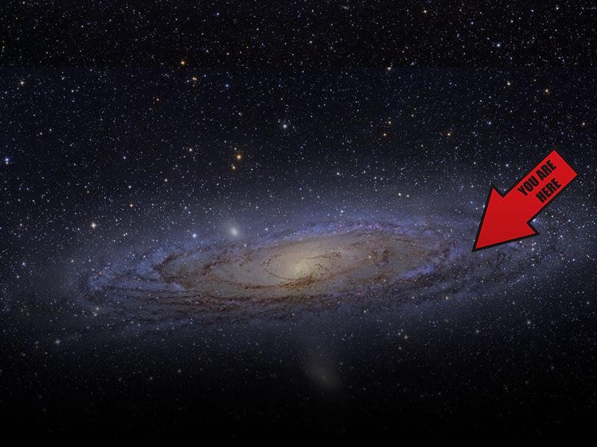
If You’re Here…
You have already heard of Node.js
Perhaps you lost a friend or family member to it
You want to know more about it

Slide 3
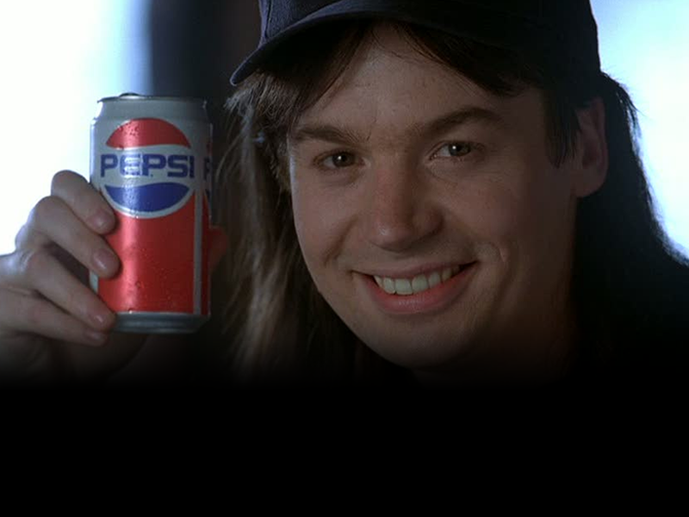
But First, A Word From Our Sponsor

Slide 4



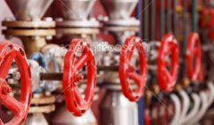
2.0
Custom Software Done Right
Solid Process, proven results
100% Cash Back Guarantee
Yes, you read that right
Set Your Own Rate
Yes, you read that right too

Slide 5
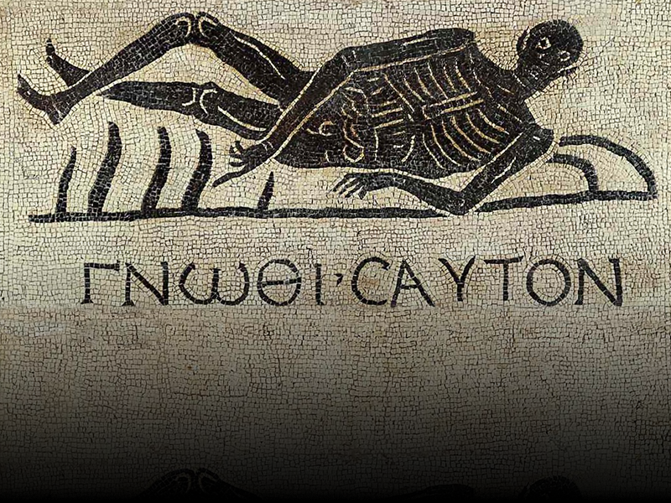
Node Thyself

Slide 6
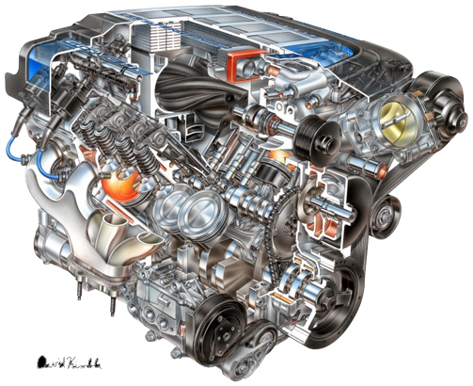
Node.js Is
JavaScript on the Server
Based on the V8 JavaScript Engine by Google
Provides set low-level of libraries
Networking
File System
Crypto
Etc.

Slide 7

Node.js Is a Different Kind Of Beast
Single threaded
Non-blocking
Driven by an event loop
Massively scalable

Slide 8
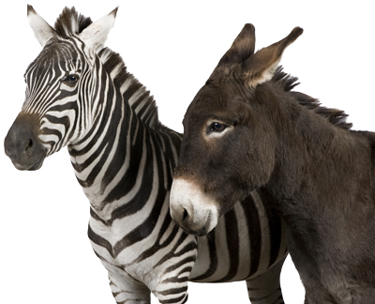
The Same But Different
Node.js
Browser
JavaScript language
No “window” object
No DOM
Has “process” object
JavaScript language
Has “window“ object
Provided by DOM
Notes:
Run node from the command line and show it off

Slide 9

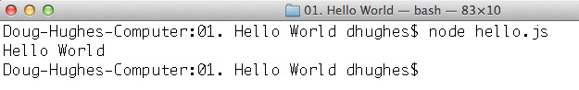
Hello World
Hello.js
//I've got something to say!
console.log("Hello World");
Run via the Console
Notes:
Can go and run in the console as well.
Note that it exits immediately.
At it’s most basic, Node.js let’s you execute JavaScript from the console.

Slide 10

Hello World Web Server
HelloWeb.js
// require loads a library we depend on
var http = require("http");
// use the http library to create an http server
var s = http.createServer(function(req, res){
// write http headers
res.writeHead(200, {'Content-Type': 'text/plain'});
// write the body
res.end("Hello Web");
});
// listen on port 8080
s.listen(8080);
Notes:
Go and run this app and note that it doesn’t exit immediately.

Slide 11
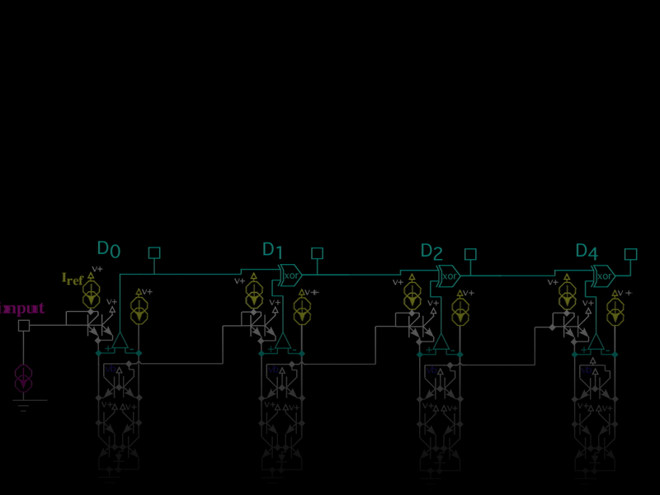
Virtually Everything Is Asynchronous
Keeps as little in memory as possible
Streams HTTP responses
While waiting for callbacks Node.js handles other events in the Event Queue
Notes:
Show the file reading example

Slide 12
JavaScript’s Event Queue
JavaScript is single threaded!
Timers, interactions, function calls, events, etc, are all added to the Event Queue.
JavaScript’s Event Loop watches for events in the queue and then handles them.
This is why stack traces in JavaScript are so… useless.
When nothing is happening, JavaScript idles.

Slide 13
Require()
I am the most boring slide in this presentation…
Loads required modules
Node provides a number of low level libraries:
Buffer
Child Processes
Cluster
Crypto
Debugger
DNS
Domain
Events
File System
Globals
HTTP
HTTPS
Modules
Net
OS
Path
Process
Punycode
Query Strings
Readline
REPL
STDIO
Stream
String Decoder
Timers
TLS/SSL
TTY
UDP/Datagram
URL
Utilities
VM
ZLIB

Slide 14
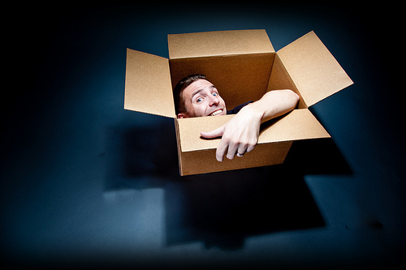
NPM – Node Package Manager
NPM is an awesome tool for managing your application’s dependencies
Use directly via the command line (like gem, port, and a plethora of other tools)
Or specify dependencies in a package.json file
Install all dependencies with “npm install”
Places dependencies into node_modules folder

Slide 15

Things I Love About Node.js
I already know JavaScript – and I like it!
See my next presentation, JavaScript: Things You Never Knew You Didn’t Know
Node.js still has that new car smell.
It has a very vibrant community and is growing rapidly.
It’s freakin’ fast and can handle large loads… when used right.
And, as a CF dev, Node.js starts up so fast!

Slide 16

Not Everyone Loves Node.js
Point
Counterpoint
Callback Hell
Relatively immature
Shallow stack traces & difficult debugging
Doesn’t use all cores
Complex calculations can be slow in JavaScript and may block your thread
Node.js is rather low level
Don’t use anonymous functions
Maturing quickly
Yup, this is a problem but there are debuggers you can use
You can fork additional processes
That’s potentially true, Node.js isn’t a silver bullet
It’s still rather easy and there are a lot of higher level modules available

Slide 17
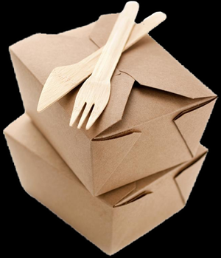
Alagad’s Experience
Our experience has been positive:
With simple test cases, node.js with Express achieved 500% greater concurrent throughput – without errors – than Apache and ColdFusion on the same hardware
I encourage you to download it and give it a whirl!

Slide 18
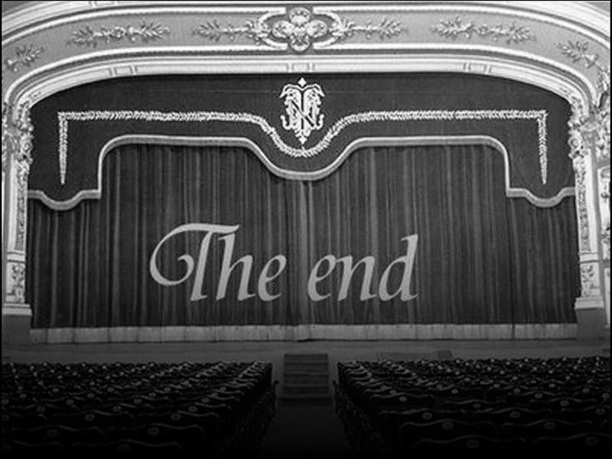
Questions & Answers

